Slide 1
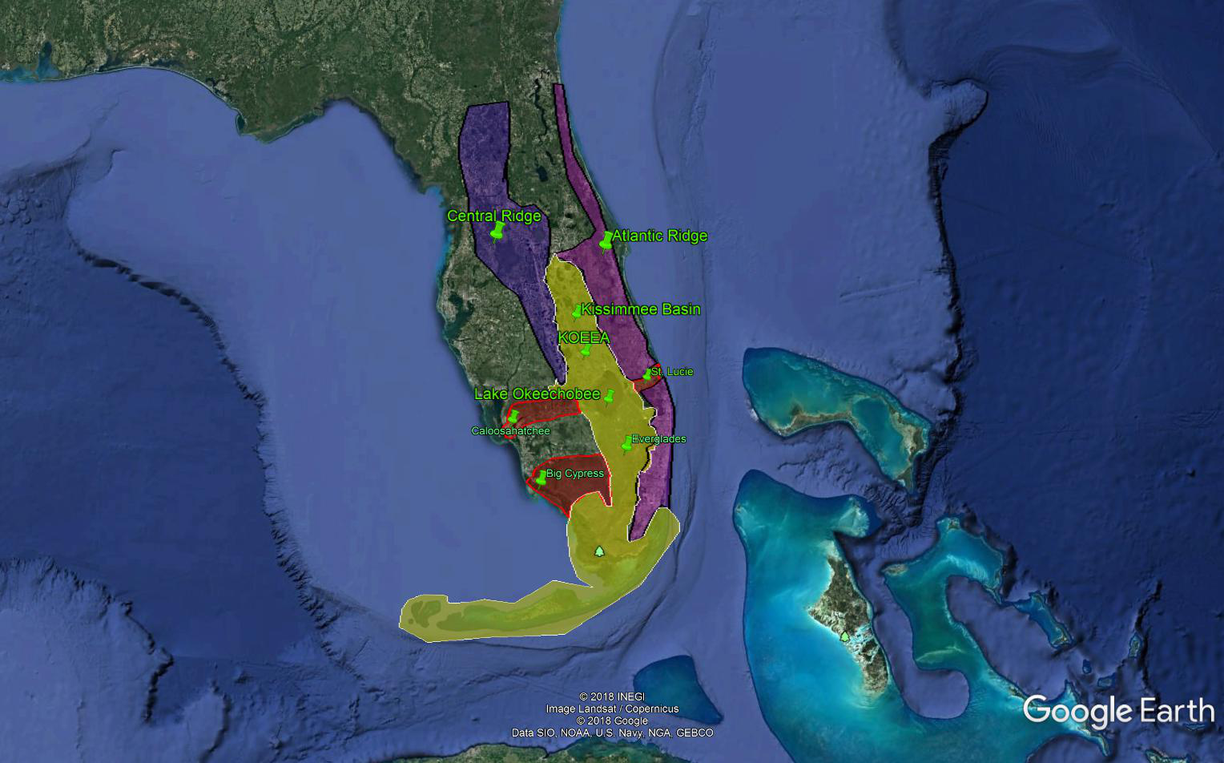

Florida and The Comprehensive Everglades Restoration Plan
(CERP)
The Good
The Bad
The Ugly
E. Allen Stewart III P.E.
eas@pasop.org
352 615 7188
Peoples’ Alliance Supporting our Obligation to Posterity
www.pasop.org
eas@pasop.org

Slide 2
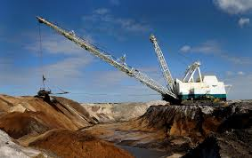
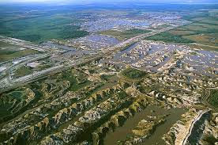
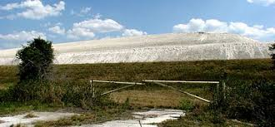
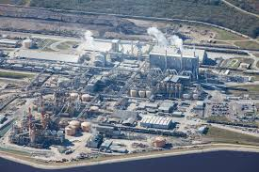
1883 began phosphate mining in Florida. Today about 25% of world phosphate is from Florida
Annually about 23,000,000 metric tons of phosphate rock is produced in Florida, resulting in 7,000,000 metric tons of P₂O_{5,} or 3,010,000 metric tons (6.63 billion pounds) of phosphorus, with a value approaching $1 billion. The bulk value of one pound of phosphorus oscillates around $0.10. The state levies a severance tax of $0.008 or less than a penny per ton of phosphate rock mined, which brings in about $46-56 million/year. On the retail market a pound of phosphorus costs about $1.80/lb when in Di-ammonium Phosphate. Therefore if I empty a two pound bag of Di-ammonium Phosphate (DAP) into a surface water the value of the phosphorus (0.46 lb) increases instantaneously from about $0.90 to $46. How? We will talk about this later.

Slide 3
Estimated Pre-Columbian Phosphorus Loading to the KOEEA
Inputs:
Rainfall: 54”/year at about 4 ppb TP-----------------72 metric tons P/yr
Dry-Fall: 3.5 µg-P/m²-day ------------------------------ 35 metric tons P/yr
Artesian Flow 2 billion gallons/day at 37 ppb------ 102 metric tons P/yr
________________
TOTAL----------209 metric tons P/yr
Present Day Estimated Net Phosphorus Loading KOEEA
Inputs:
Rainfall: 54”/year at about 9 ppb TP---------------162 Metric Tons P/yr
Dry-Fall: 118 µg-P/m²-day ---------------------------1,180 Metric Tons P/yr
Point Sources 1.22lb-P/yr-capita------------------555 Metric Tons P/y Fertilizer P (improved pasture, sugarcane)------ 2,850 Metric Tons P/yr
Livestock Feeds (Mostly Dairy)--------------------- 1,530 Metric Tons P/yr
Artesian Flow--------------------------------------------102 Metric Tons P/yr
____________________
TOTAL--------6,379 Metric Tons P/yr
________________
TOTAL----------40,786,000 lb-P/yr

Slide 5
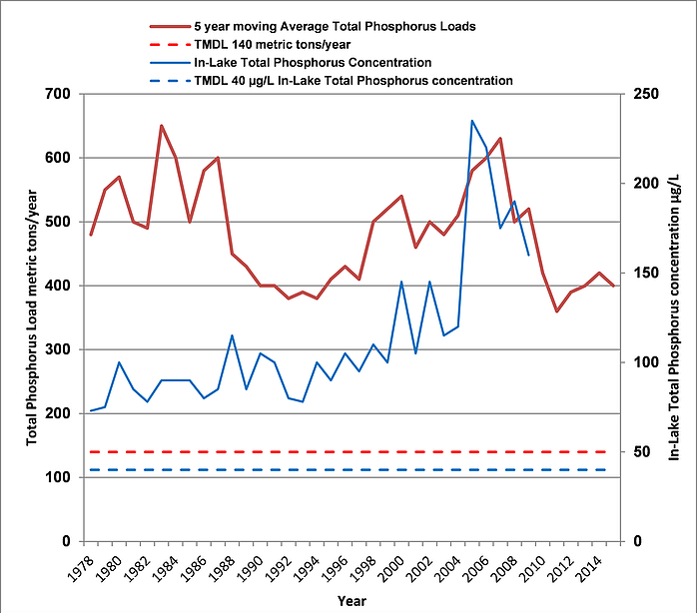

Slide 6
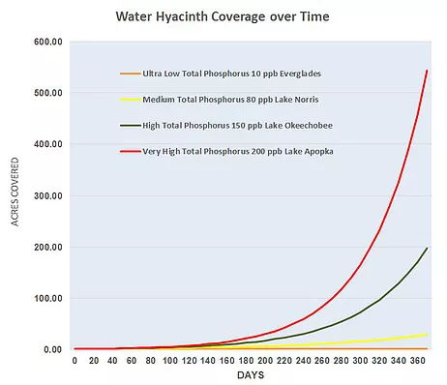

Slide 7
In a 2015 report by the University of Florida Water Institute it was noted that over 110,000 tons of available phosphorus is stored in the Okeechobee Watershed alone—enough to load the lake with 500 tons per years for the next 200 years! This excess stored phosphorus they call legacy phosphorus—I prefer to call it rogue phosphorus! In the report they note that “Beyond existing and planned approaches, the substantial reservoir of legacy (rogue) phosphorus in the Northern Everglades watersheds will necessitate new and more aggressive strategies to combat the mobility of phosphorus.”
“Increased and sustained State and Federal funding is critical to provide additional water storage and treatment before the system becomes so degraded that major attributes reach tipping points that cannot be reversed.”
​

Slide 8
WHAT DO WE WANT FLORIDA and the KOEEA TO BE???
Major Environmental Issues Today in Florida
Extensive drainage and water control has caused abrupt changes in the ecology of wetlands (such as the Everglades), rivers, estuaries and springs
Excessive Nutrient Loadings into surface freshwaters has stimulated expansive growth of invasive plants and large blooms of Blue-Green algae, which can be toxic to humans and fish. It has also promoted the deadly amoeba Naegleria making many Florida lakes un-swimmable, and is likely contributory to increased levels of red tide (Karenia breve)
Nutrient loading has also caused deterioration of coral reefs in the Keys.
Residual pesticides and herbicides and related moieties have been deleterious to aquatic plants and animals
Introduction of exotics such as Burmese Pythons, lionfish, and melaleuca have caused degradation of ecological stability
Disruption of water allocation patterns through diversion and drainage have caused damage to coastal ecosystems.
Red tide blooms threaten fisheries, hurt tourism, and are toxic to humans
Groundwater contamination with excessive nitrates from agriculture have caused loss of eel grass lawns and water quality in Florida’s Springs.
Global climate change and rising sea levels are causing flooding problems and major ecological changes along the coast.
Development is encroaching upon critical habitats
Extensive dredging and heavy boat traffic is imposing upon grass flats in Florida’s estuaries.
No political will to regulate agriculture and development

Slide 9
To reiterate the strategy of CERP:
Expand water storage to make up for lost floodplain wetlands by building elevated deep reservoirs and using ASR
Retain agriculture within the 640,000 acre EAA
Reduce phosphorus coming from the EAA through expansive passive wetlands call Stormwater Treatment Areas or STA’s
Increase flow to the Everglades with highly treated water which meets standards of circa 10 ppb phosphorus
Implement Best Management Practices for agriculture to reduce water consumption and nutrient discharges
Restore Kissimmee River Oxbows
Support Total Maximum Daily Load (TMDL) goal of 140 tons/year and 49 ppb phosphorus into Lake Okeechobee, and the resulting Basin Management Action Plan (BMAP)
Implement CERP with sensitivity to Endangered Species Act
Do we want the KOEEA to be dedicated primarily to Agriculture and Development? Or do we want the KOEEA to be a balanced ecosystem which serves to provide high quality water to its wetlands, lakes, rivers, and estuaries at a schedule amenable to protection of these ecosystems, and to the high quality of life and economic value they offer? Can we have both? How?

Slide 10
What are CERP’s Flaws and Failings?
8) The Agencies early on decided Stormwater Treatment Areas (STA) which are expansive constructed wetlands would be the primary means of reducing phosphorus. These only store phosphorus and eventually have to be dredged out. In addition they do not include any meaningful recovery or crop development. STA’s were used in favor of truly sustainable technologies which removed and recovered phosphorus
9) Large deep reservoirs were planned by the ACOE without consideration of water quality impacts
5) There was no thought given to management of legacy or rogue phosphorus.
10) The science of the systems was not given sufficient respect in developing CERP. Additionally, the science was not that well understood. Those who did understand the science were often ignored.
6) All phosphorus reduction methods involved storage rather than actual removal and recovery
7) No real incentives were offered to the private sector to contribute to phosphorus reduction.
2) The directive of CERP was to serve two masters—Ag and Development and Ecosystem stability. In deciding this, the agencies mistakenly thought they could negotiate with proven scientific principles such as the Conservation of Mass. You can’t, no more than you can negotiate with the Law of Gravity when falling out of a plane. The reasonable guiding directive should have been to drive the system back towards a near equilibrium state if they were serious about avoiding deleterious environmental disruptions such as those we see now.
3) In the development of CERP, there was no serious thought given to securing the 640,000 acres of the EAA through eminent domain and returning it to viable habitat or which could be used for water storage and treatment. Same with the recovery of floodplain to the north. I consider the EAA the elephant in the room.
Projects depend upon annual Federal allocations. This has often been held up for political reasons, or simply as a result of funding priorities. This injures project effectiveness, as noted by UF “Increased and sustained State and Federal funding is critical to provide additional water storage and treatment before the system becomes so degraded that major attributes reach tipping points that cannot be reversed.”
4) There was no evaluation of the long-term economic impacts of sugarcane cultivation in the EAA as compared to returns from recovering the EAA as habitat and storage/treatment.

Slide 11


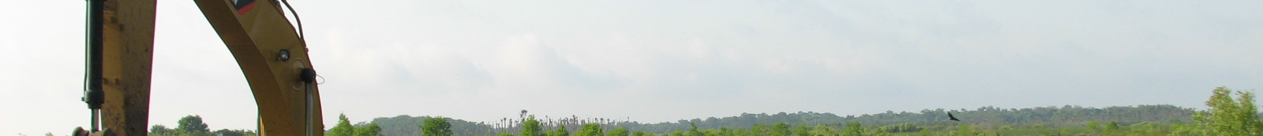
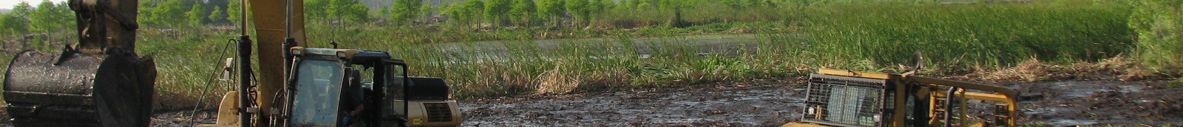
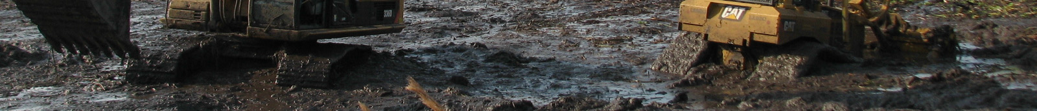
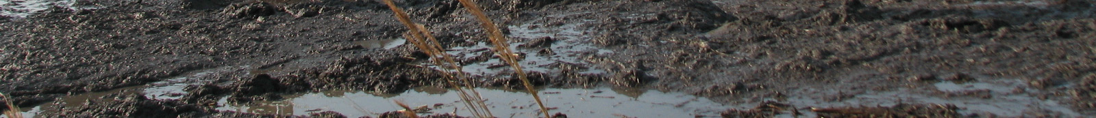
Removal of Accrued Sediment Orlando Easterly Wetland

Slide 12
CERP IS LITTLE MORE THAN C&SF Ver 2.0. IT DENIES BASIC SCIENCE IN FAVOR OF SHORT-TERM INTERESTS WITHOUT CONCERN FOR ENVIRONMENTAL STABILITY, LONG-TERM ECONOMIC INTEGRITY OR ISSUES RELATED TO THE PROTECTION OF POSTERITY. IT IS GREED SHROUDED IN GREEN CLOTHING
SO WHAT MEASURES COULD BE TAKEN TO MAKE A NEW CERP EFFECTIVE?

Slide 13
PROPOSED REVISION #1
State up front that the goals of CERP in terms of environmental and economic restoration are to regain a near equilibrium state in terms of material inputs and outputs, and that programs should be developed and incentivized that ensure agricultural and development activities retain this near equilibrium state. Only when there is such a balance can the system begin to resemble a functional stable system

Slide 14
PROPOSED REVISION #2
Use the power of Eminent Domain as allowed through the Fifth Amendment of the Constitution to secure lands essential for restoration of the KOEEA. The most Obvious is the 640,000 acres of the Everglades Agricultural Area (EAA) which represent 27% of the historical Everglades. It may be argued that elimination of this much farmland will create severe economic stress, but the agriculture is largely in sugar cane (450,000 acres) controlled by two companies. Through the Farm Bill we have subsidized the sugarcane industry in Florida by providing price guarantees for government buy-back and placing quotas on foreign providers. This costs the American people about $3.0 billion each year. And yet, in spite of advertising to the contrary, the sugar industry in Florida according to a UF study, contributes only $2.06 billion and 22,648 jobs (many low paying) to the economy. Among a group of the top seven agricultural commodities in Florida, sugar is number five . Number one is Environmental Horticulture at $8.42 billion and 165, 894 jobs. The total value added of sugar is 0.26% of the state GDP and 0.21% of the state employment. For this contribution we have imposed heavily on tourism, property values, and human health as we take efforts to regulate water within the EAA, and divert flows east and west to the coasts. A transition program would be implemented to facilitate transfer of EAA lands from traditional cultivation to water storage recovery, nutrient recovery facilities, and reclaimed Everglades habitat.
If we do not secure the EAA as part of a restoration, we can not expect any environmental stability within the KOEEA, and CERP will fail.

Slide 15
PROPOSED REVISION #3
Use the power of Eminent Domain as allowed through the Fifth Amendment of the Constitution to recover lost floodplain, much of which is in pasture. Some recovery is already underway in the Kissimmee River Reclamation. As improved pasture is a major contributor to phosphorus loading north of Lake Okeechobee, it makes sense to either purchase improved pasture for return to floodplain wetlands, or to lease this land through the Owner in exchange for return to floodplain. Recently the South Florida Water Management District (SFWMD) has been pursuing this option to a limited extent.

Slide 16
PROPOSED REVISION #4
Develop and Implement a long-term nutrient removal and recovery program that 1) significantly reduces the amount of phosphorus brought into the KOEEA and 2) removes and recovers rogue phosphorus as well as input phosphorus, thereby depleting the excess phosphorus stores over time, allowing the system to realize an input-output balance. Phosphorus removal and recovery can be accomplished three ways:
Dredging and recovery of dredge solids as a marketable soil amendment
The application of certain metal salts such as aluminum sulfate (Alum) which can remove and precipitate phosphorus which can be recovered and removed. This may be supplemented with various filtration techniques.
The use of select plants, in particular aquatic plants, which when cultivated through frequent harvesting, uptake nutrients and allow the harvested crop to be used in the production of products such as compost, potting soil, livestock feeds, fiber products, various extracts, and biogas. This technology is known as Managed Aquatic Plant Systems or MAPS
While all three approaches can and likely should be applied at some level, MAPS has the greatest potential for developing into a large scale agri-industry.

Slide 17
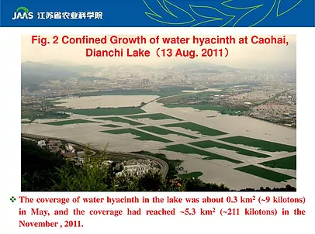
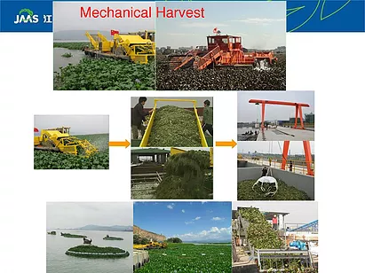
PROPOSED REVISION #5
Transition away from extensive herbicide use, as lowered nutrient will reduce the rate at which invasive plants return. The herbicide application program shall be approved not only by the FWC and/or the Water Management Districts but also an ad hoc committee made up of impacted stockholders and objective, uninvolved scientists. At the same time, additional effort shall be directed towards the use of mechanical harvesting and recovery programs as an additional means of reducing surface water nutrients. The cultivation, harvesting, and reuse of aquatic plants such as water hyacinths is presently being done within nutrient enriched lakes in China on a large scale.

Slide 18
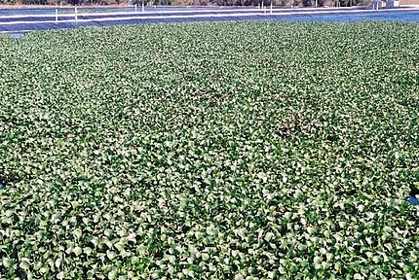
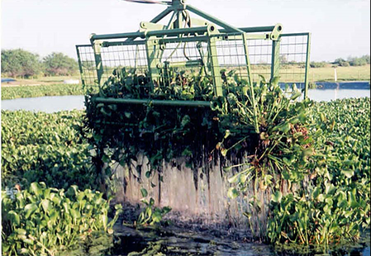
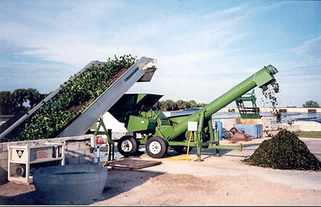
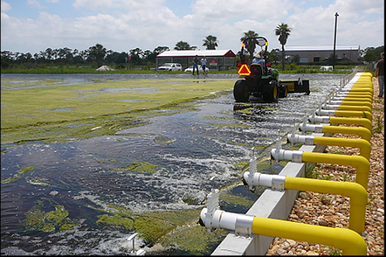
MANAGED AQUATIC PLANT SYSTEM

Slide 19
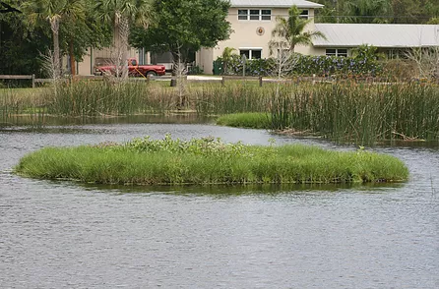
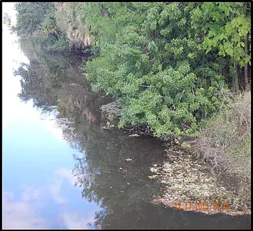
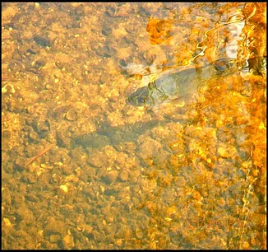
BEFORE
AFTER
BEEMATS

Slide 20
PROPOSED REVISION #6
Eliminate septic tanks and upgrade wastewater facilities to include higher levels of nutrient reduction.
PROPOSED REVISION #7
Encourage development of ordinances and provide incentives for native plant landscaping, to include prohibition of inorganic phosphorus fertilizers.
PROPOSED REVISION #8
Negotiate a Pay-For-Performance Agreement to reward private enterprises for removing and recovering phosphorus from the KOEEA.
PROPOSED REVISION #9
Contract with an independent scientific think tank like the Santa Fe Institute to review comment and recommend regarding planned projects and strategies
PROPOSED REVISION #10
Construct bridges over critical floways and fill in existing canals as deemed appropriate for system function

Slide 21
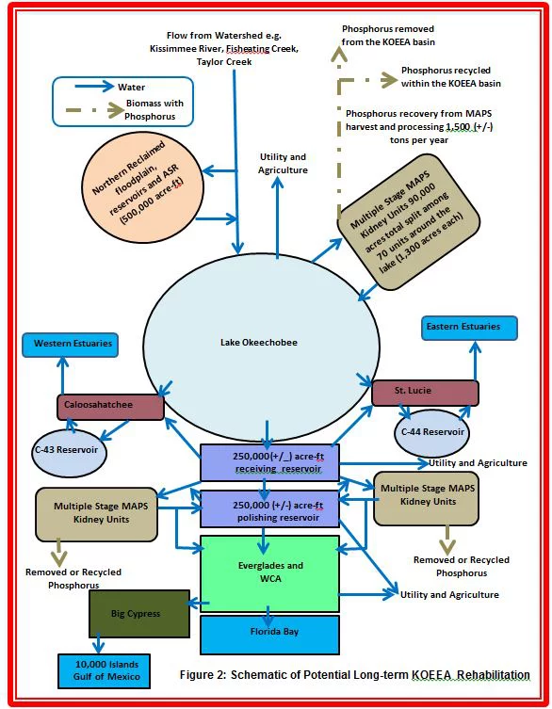
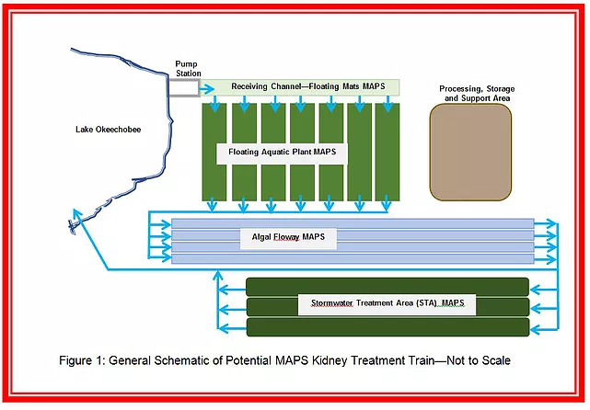

Slide 22
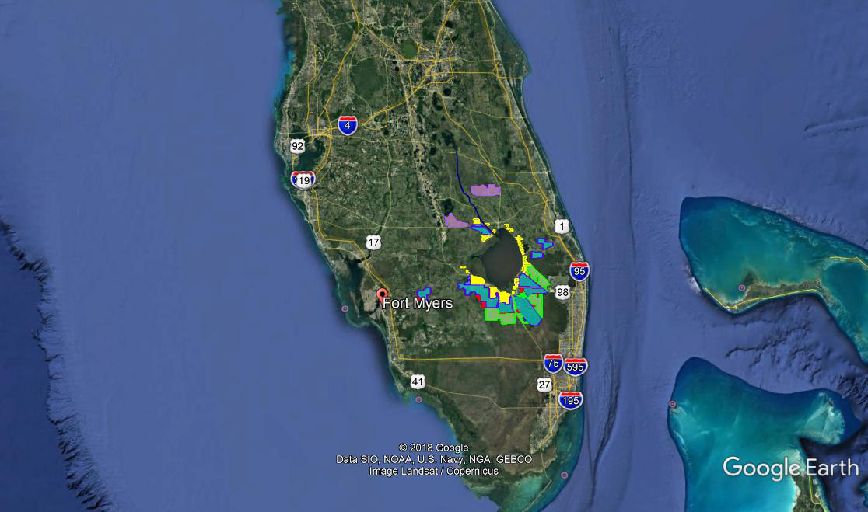
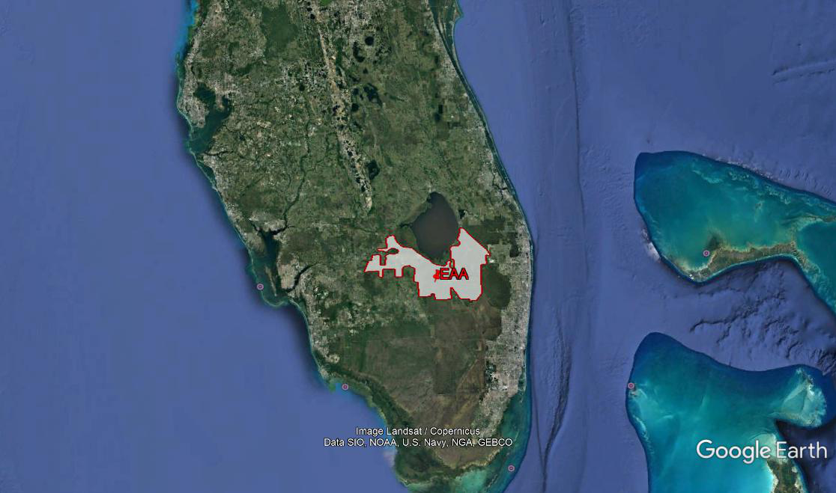
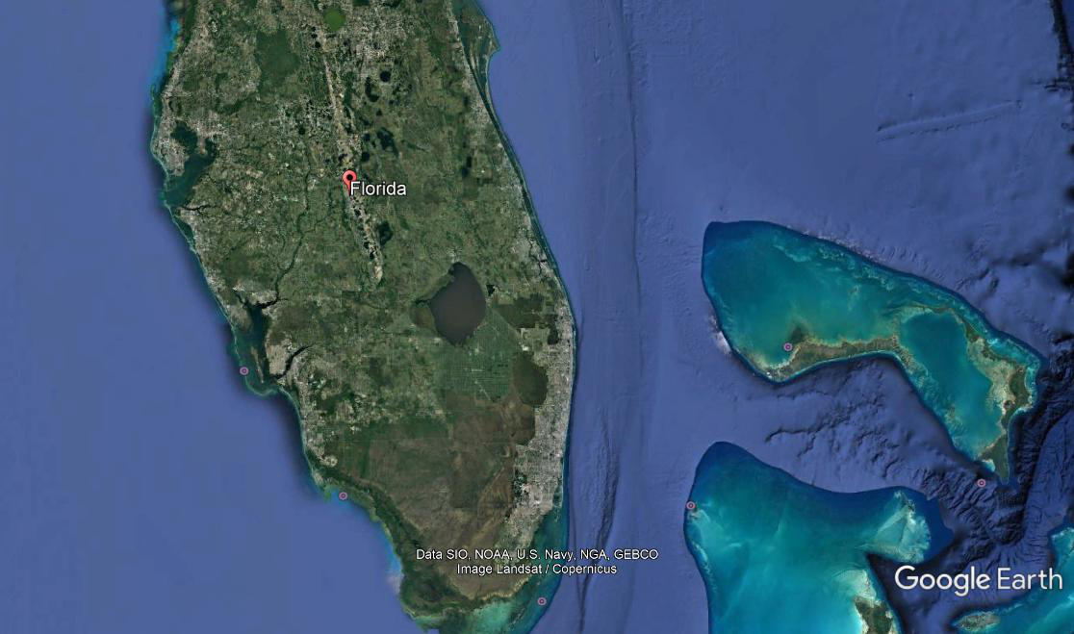
Kidney MAPS
Reclaimed Floodplain
Reclaimed Everglades Habitat
Shallow Reservoir
Reservoir MAPS
Kissimmee River Restoration

Slide 23
So, what will this new CERP cost? The original budget was a total of about $6-7 billion dollars to be completed in 2020. It has been expanded to $8-9 billion with completion in 2030. The new CERP as proposed here will likely cost upwards of $20 billion and be built out around 2050, with the rogue phosphorus under control and the system back in equilibrium by about 2080. Too much you say—well do less and the coke bottle will not be completely put back together. What do you have then??

Slide 24
It is not about change—the environment on earth will change, it has always changed. It is about the rate of change, and this is something upon which we can have some influence! We can facilitate change very quickly, and it is quite possible these changes will force change, and perhaps even elimination, of our great societies, but life on earth will continue without us. We are not going to kill the earth, but we may render it inhabitable for humans.

Slide 25


ECONOMIC GROWTH Vs. ECONOMIC BALANCE

Slide 26

Remember, Pogo the ‘Possum said it Best

